Slide 1
Lab 1: Version Control
Spring 2019 - CSE 455: Git Tutorial

Slide 2
What is Version Control?
A system that records changes to a file or set of files so that they may be recalled later.

Slide 3

What is Git?
The most popular version control system in the world!

Slide 4

Role-Based Codelines and Disposable Experimentation

Slide 5
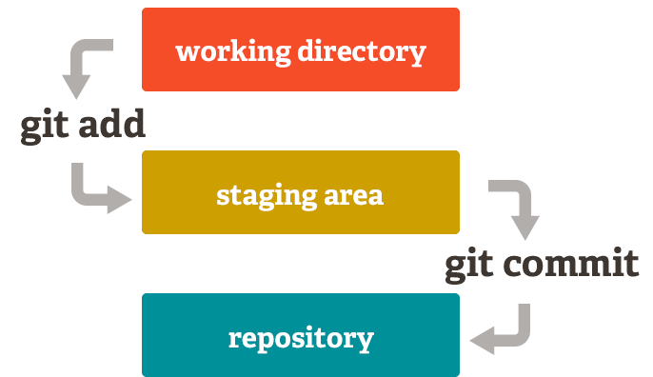
Staging Area

Slide 6



Popular Git Hosts

Slide 7
Lab 1 Git Assignment
Make a repository on Bitbucket (https://bitbucket.org/) titled LastFirstname-CSE455.
Create 4 folders labeled Lab 1, 2, 3, and 4. In the Lab1 folder, have a .txt file containing your name and student ID. The commit comment should include “This is lab 1”. *Git does not allow empty folders to be pushed.
Share the repository with the MAD Team (csusbmad).
Be very sure to share your repository with “csusbmad” in order for us to grade all of your laboratories this quarter
Due by TBD

Slide 8
How to do Assignment #1
On your local machine:
git clone URL_OF_YOUR_REPOSITORY
Make your folders and files in the new repo folder. Then navigate to the folder:
git add Lab\ 1
git commit -m “This is lab 1”
git push origin master
That’s it!

Slide 9
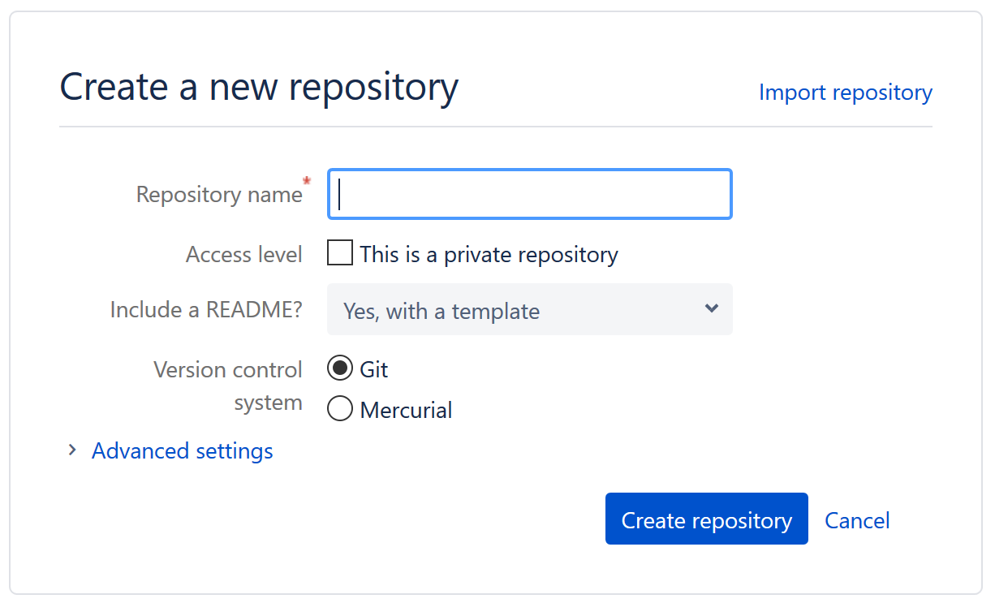
Create Your New Repository For CSE 455 Labs
Firstly, everyone must be logged into Bitbucket
Create a new repository on the following menu screen
Be sure to name your repository as: <LastnameFirstname-CSE455>

Slide 10
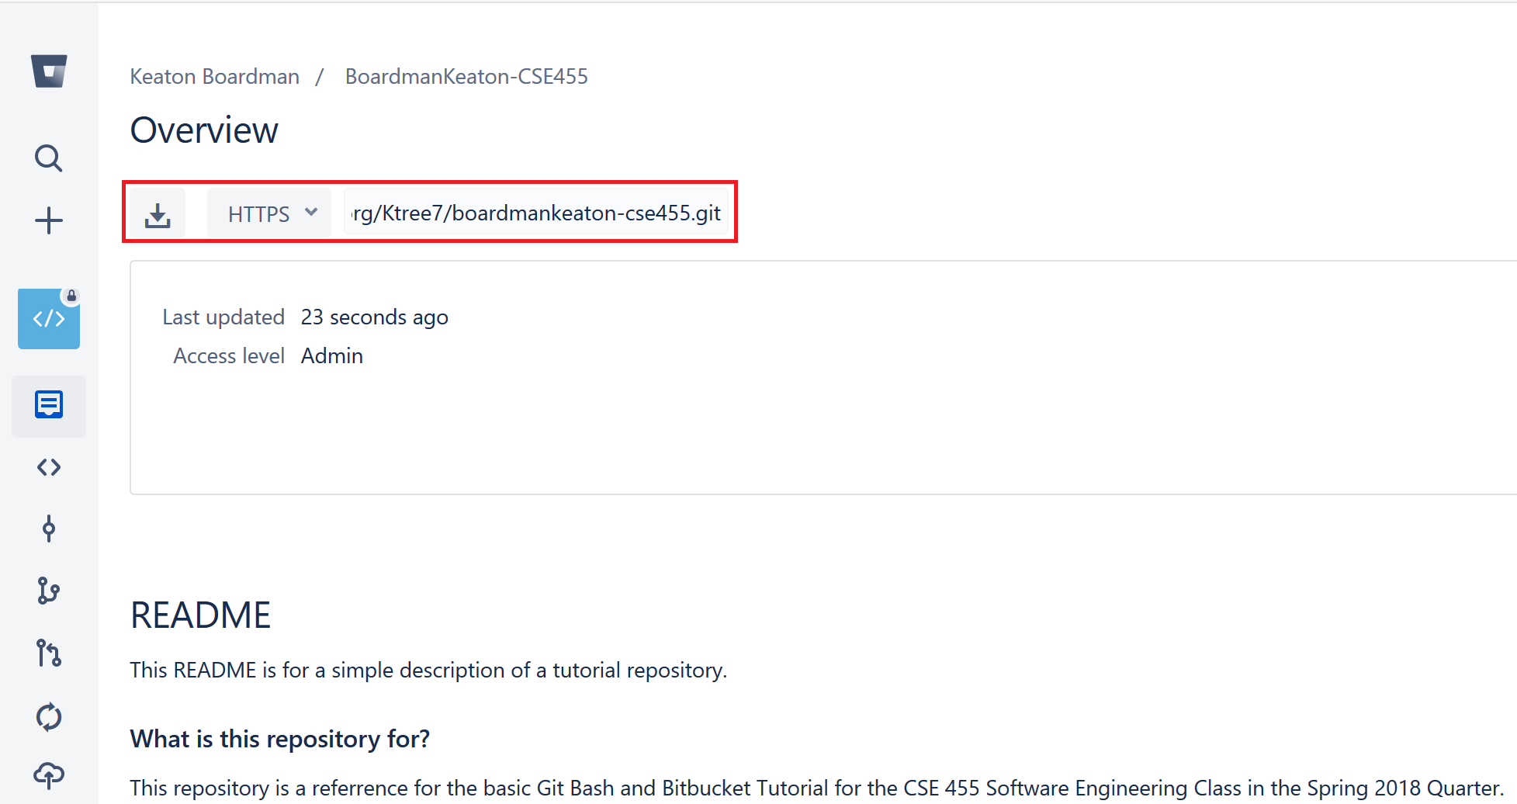
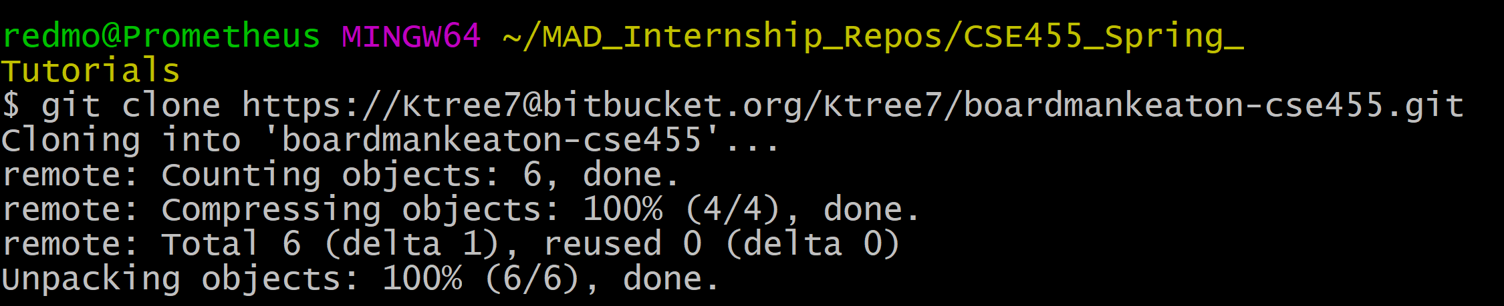

Slide 11
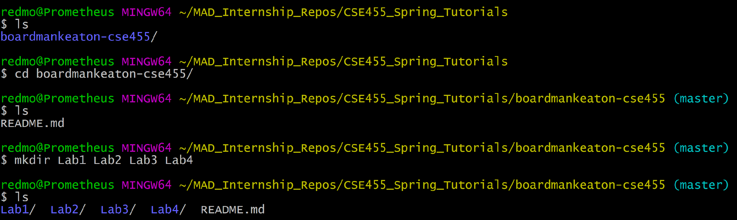
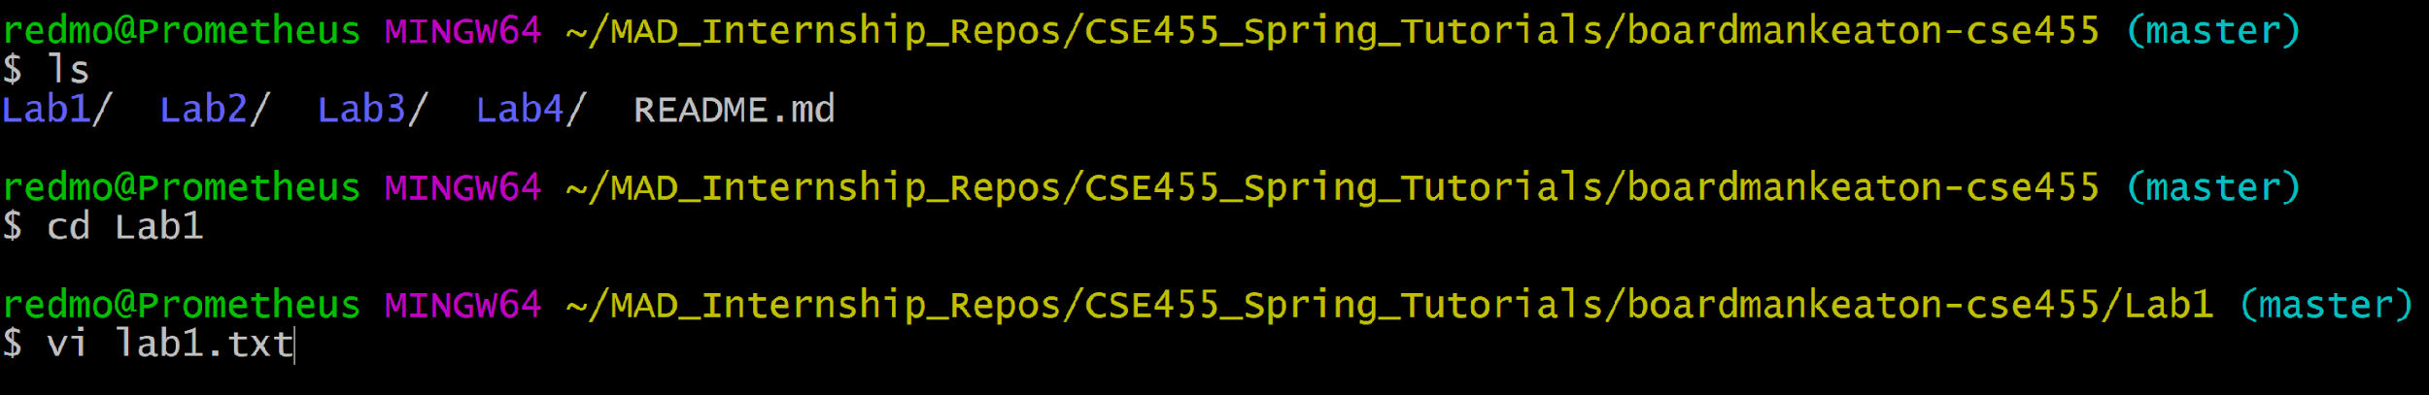
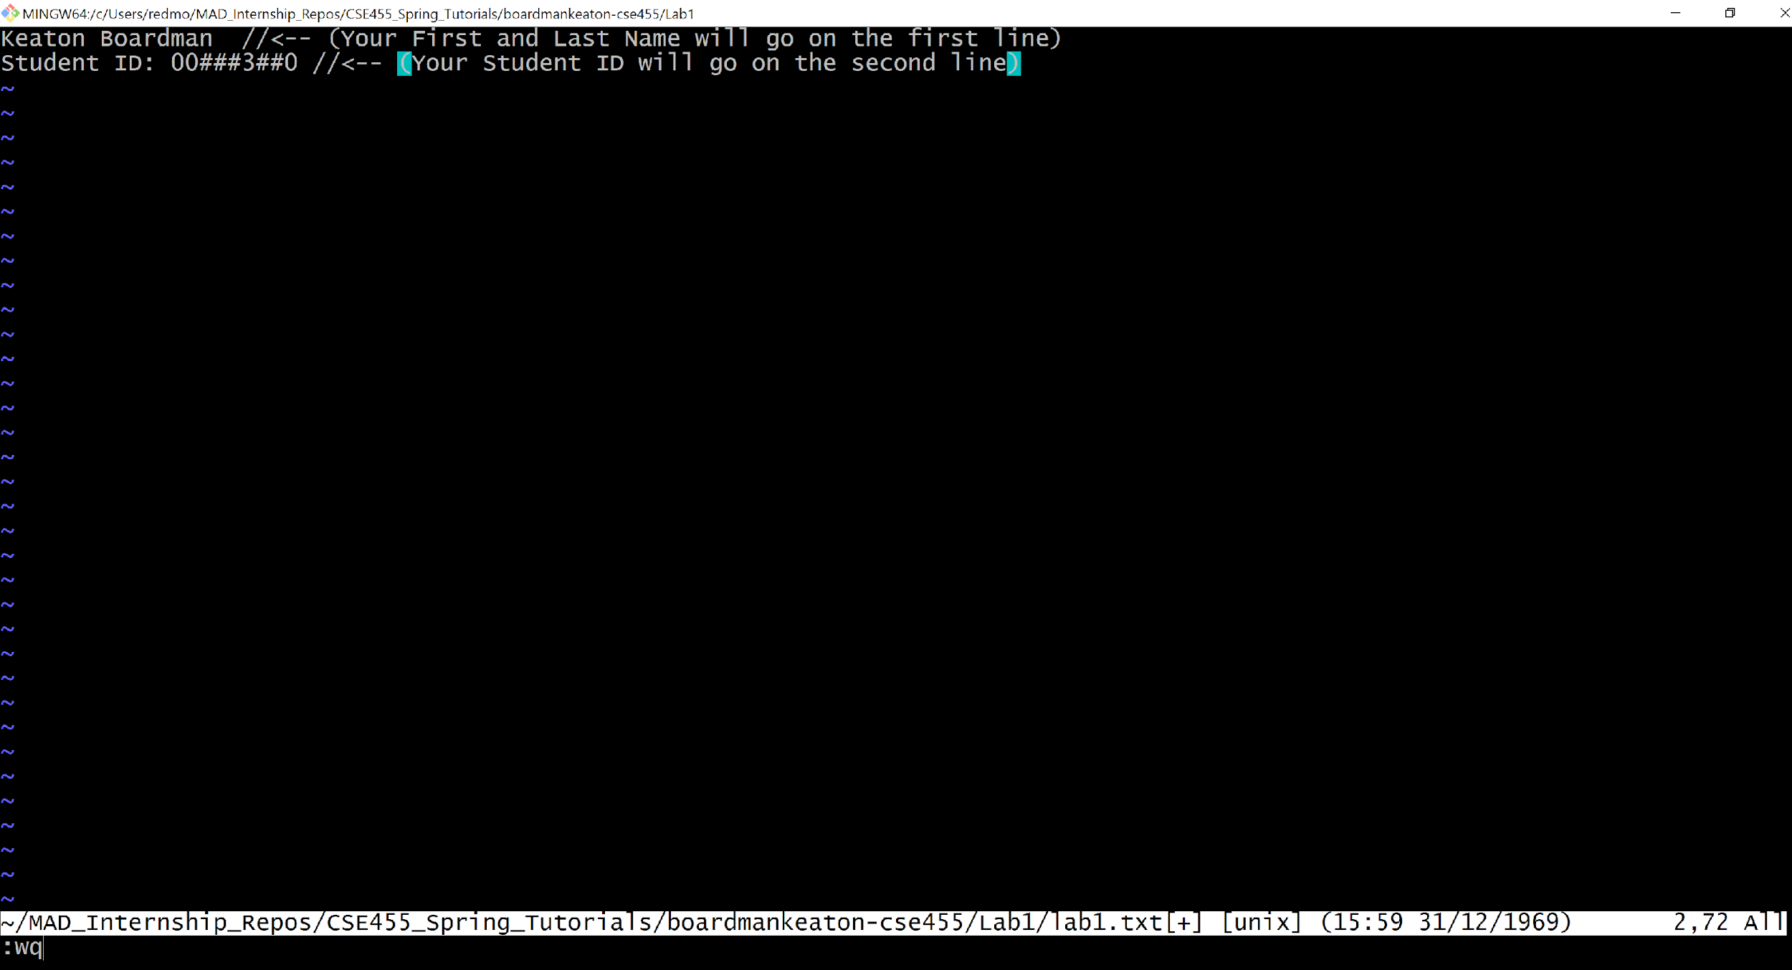

Slide 12
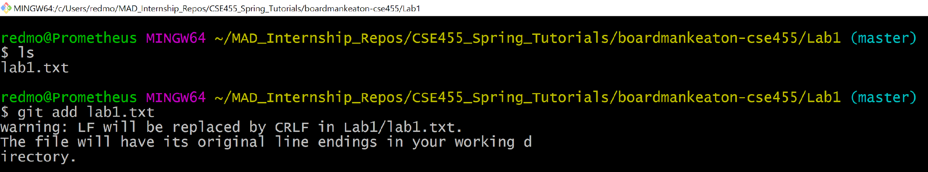
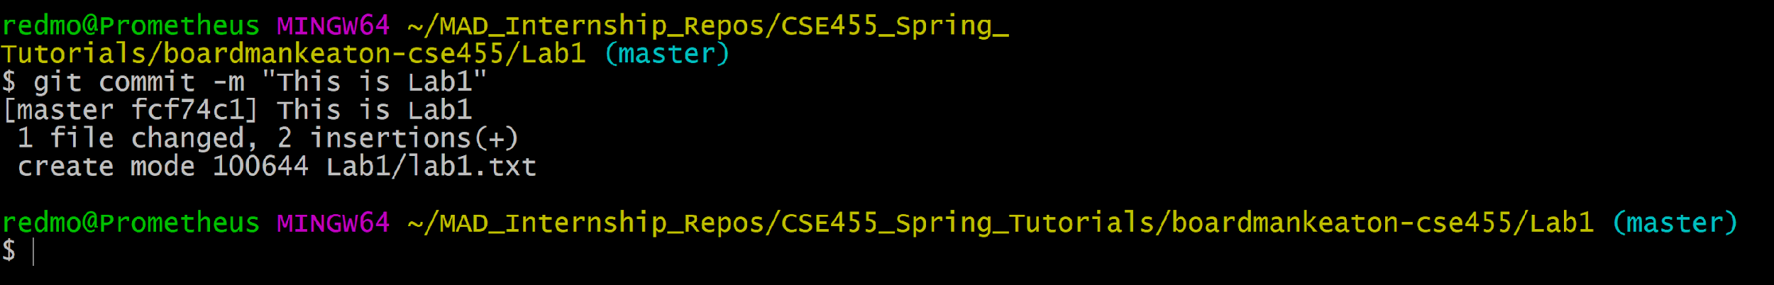
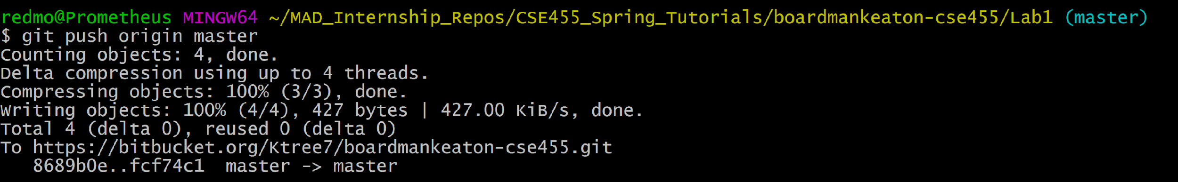
The git add, commit, and push commands
(Ignore the warning Git Bash displays)

Slide 13
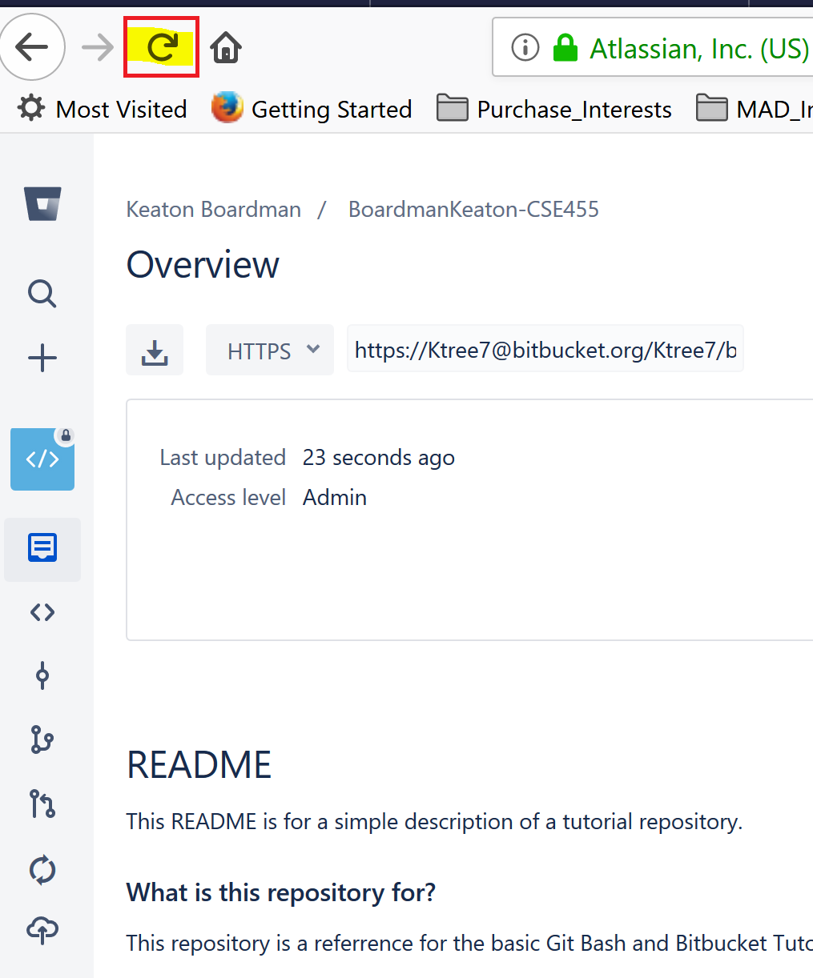
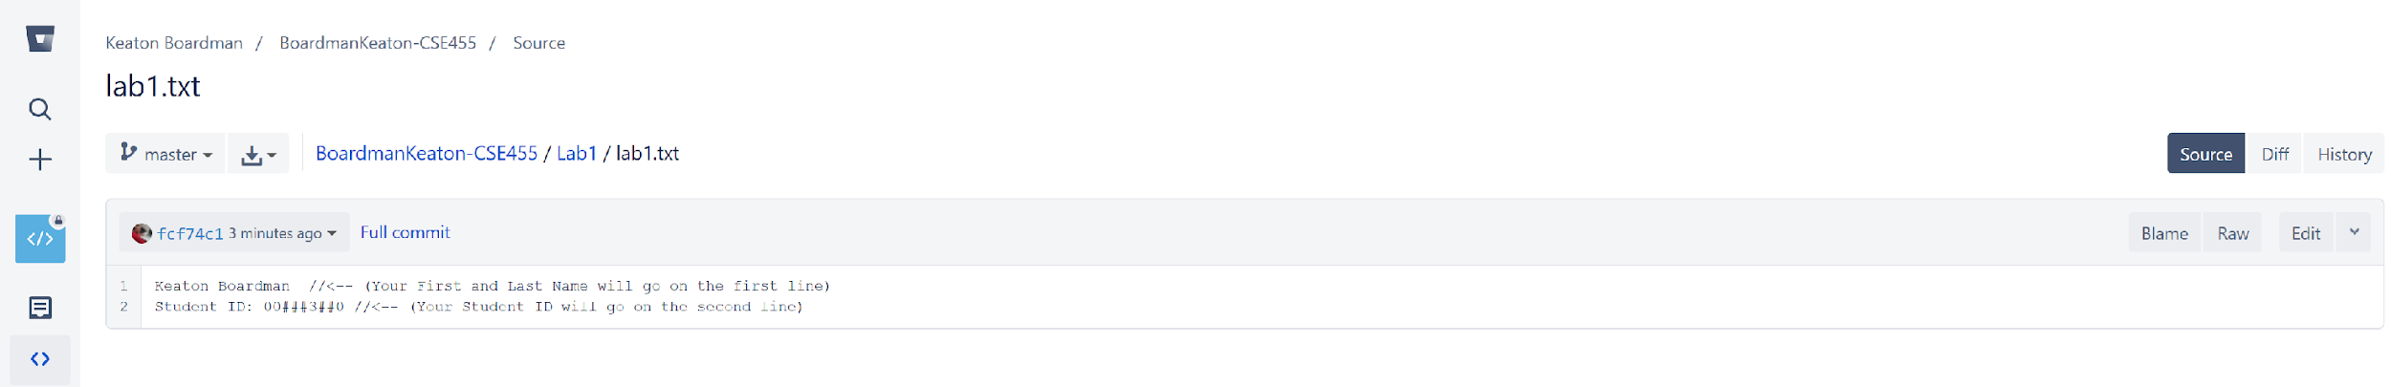

Slide 14
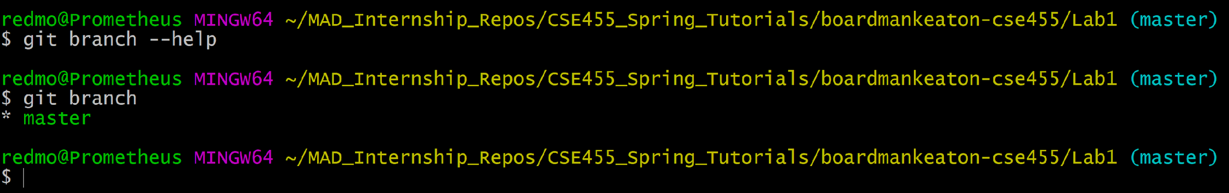
How to branch, create a development branch
The screenshot below is how to create a new branch; notice the (master) label on the right indicating that we are currently in the master branch

Slide 15
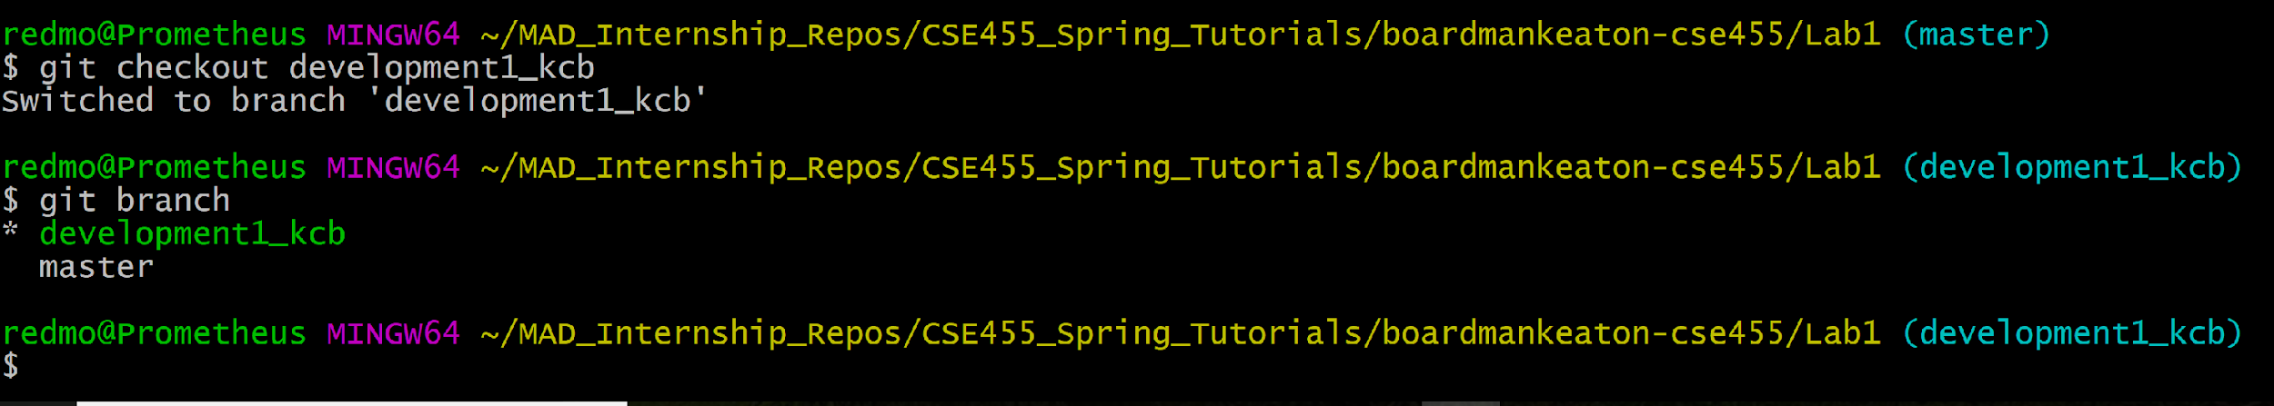
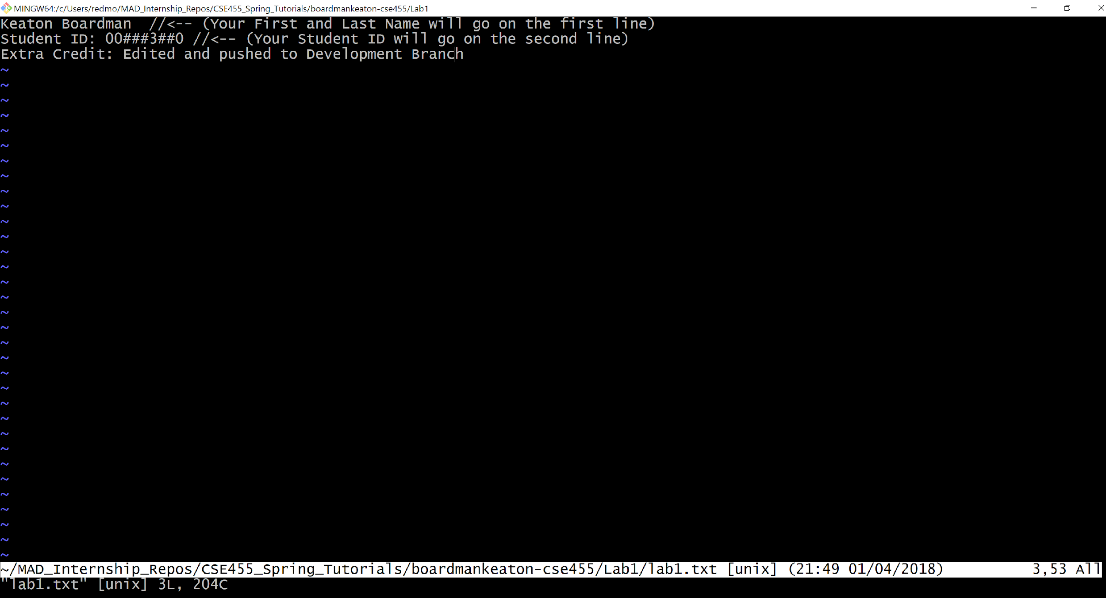
Switch to development branch using git checkout

Slide 16
